Slide 1
BIG DATA ANALYTICS Keerthana(CSA2160) Kiruthika G(CSA2163) Dhanya R(CSA2160)

Slide 2
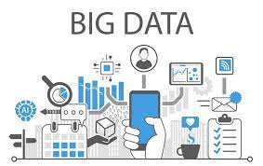
INTRODUCTION OF BIG DATA
Big Data refers to huge amount of data that can be stored and processed using the traditional computing approach within a given time frame.

Slide 3

EXAMPLE OF BIG DATA
For example, if we try to attach a document that is of 100 megabytes in size to an email we would not be able to do so. As the email system would not support an attachment of this file.
Therefore this 100 megabytes of attachment with respect to email can be refered to us big data.

Slide 4

BIG DATA ANALYTICS
Big Data Analytics is a process to extract meaningful insight from big such as hidden patterns, unknown correlations, market trends and customer preferences.

Slide 5
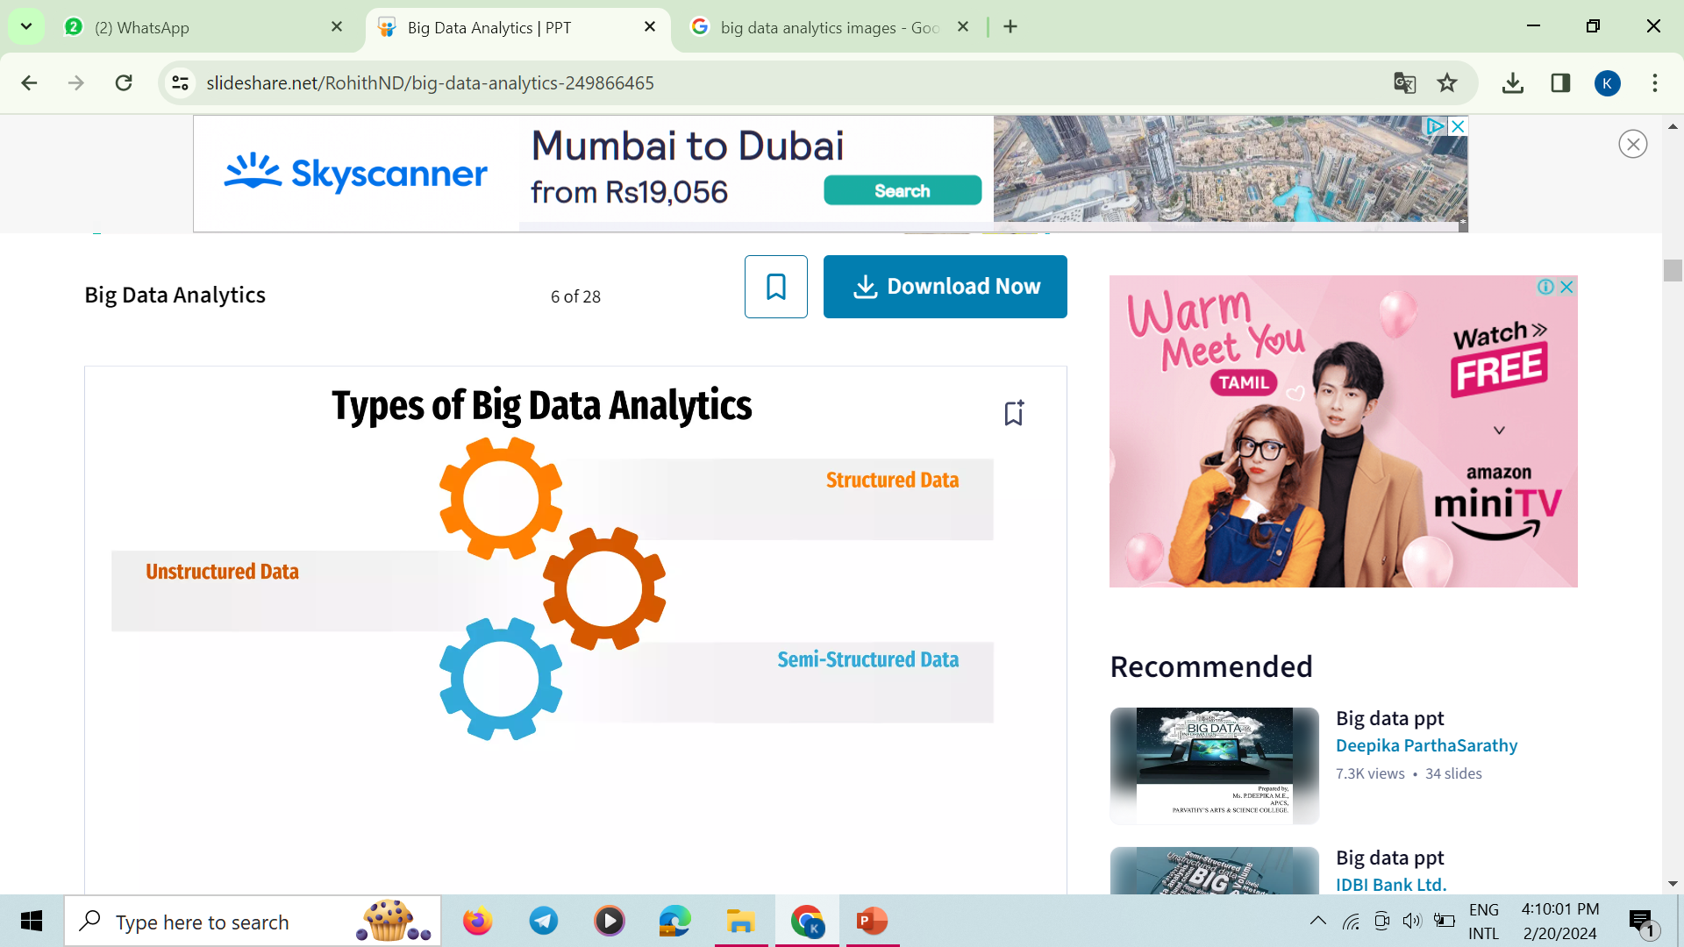
TYPES OF BIG DATA ANALYTICS

Slide 6
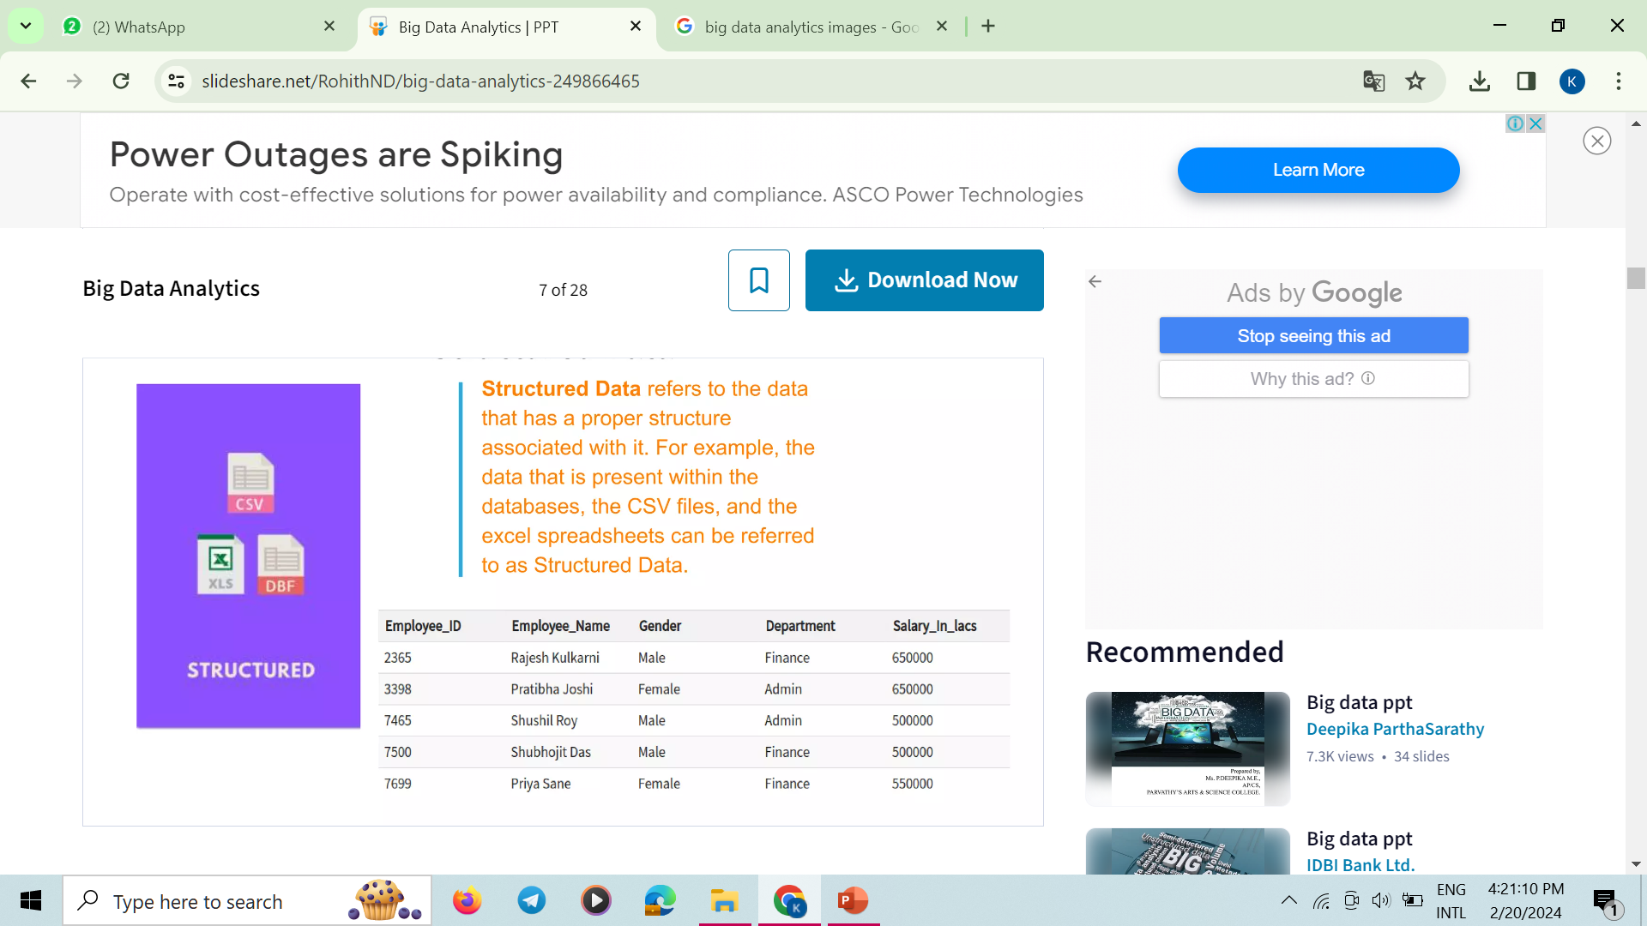
STRUCTURED DATA
Structured data refers to the data that has a proper structure associated with it.
For example ,the data that is present within the databases , the CSV files and the excel spreadsheet can be referred to us structured data.

Slide 7
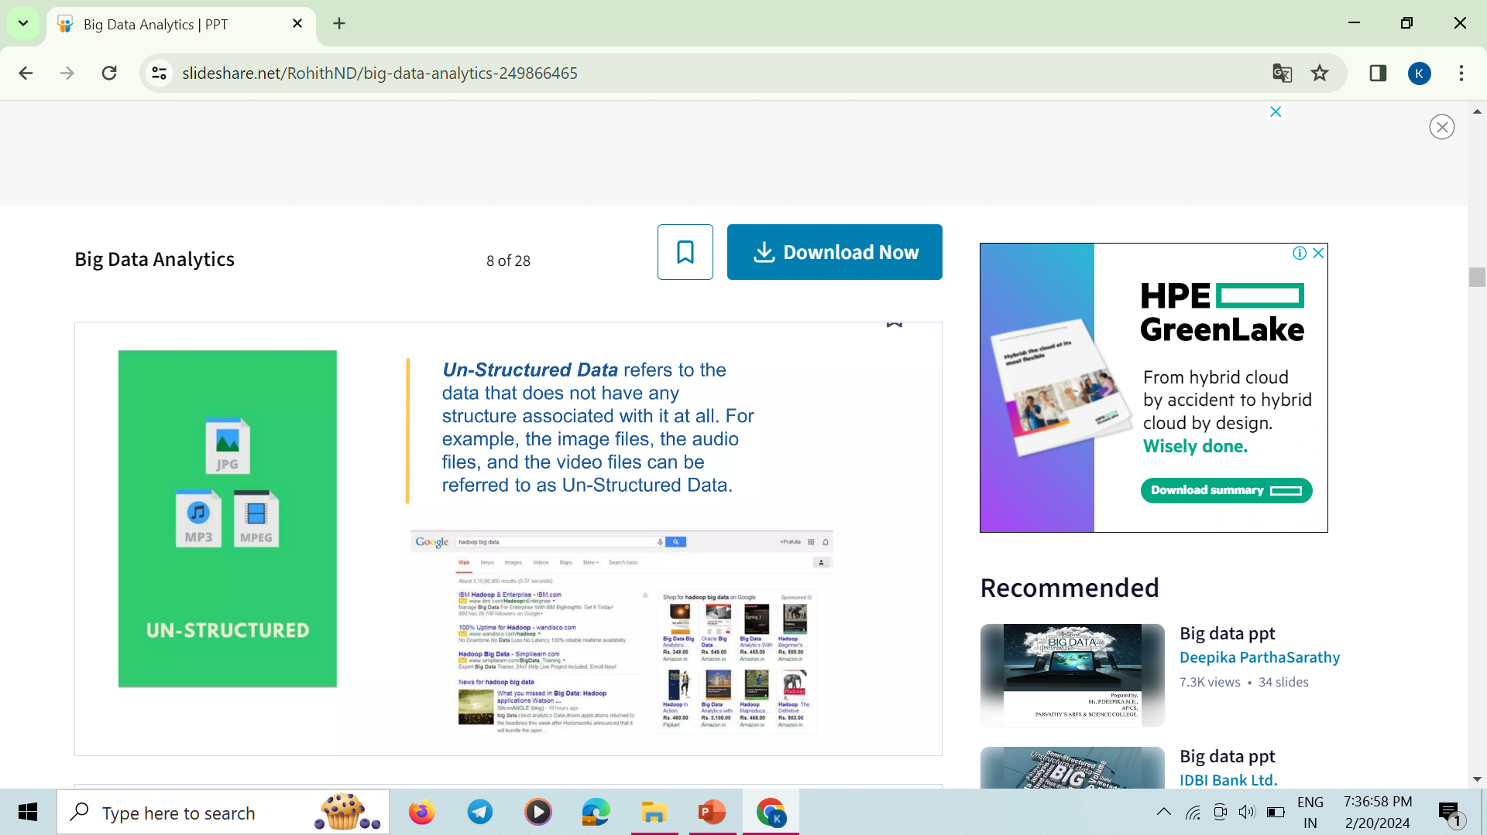
UNSTRUCTURED DATA
Unstructured data refers to the data that does not have any structure associated with it at all.
For example , the image files ,audio files and the video files can be refered to as unstructured data.

Slide 8
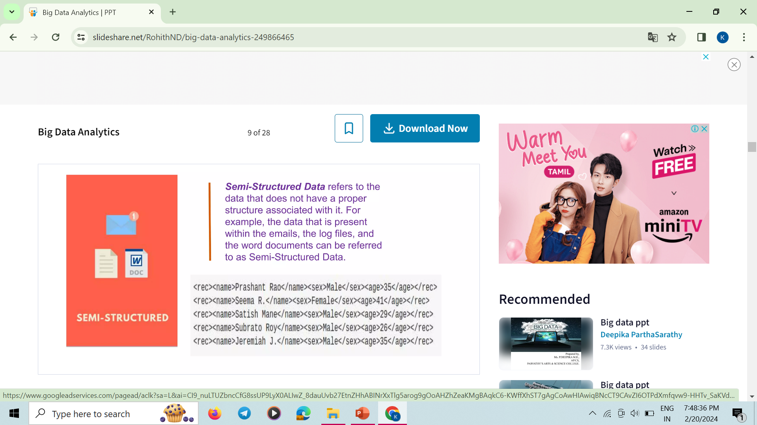
SEMI-STRUCTURED DATA
Semi-structured data refers to the data that does not have a proper structure associated with it.
For example , the data that is present within the emails,the log file and the word document can be refered to as semi-structured data.

Slide 9
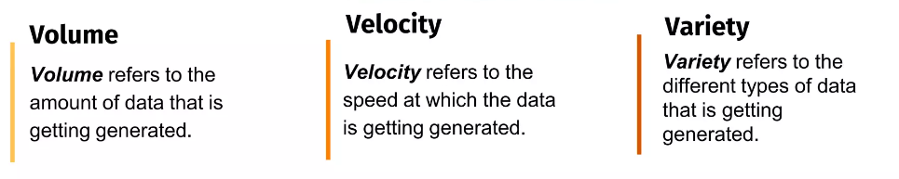
CHARACTERISTICS OF BIG DATA
Big data is categorized into 3 characteristics:
Volume
Velocity
Vareity

Slide 10
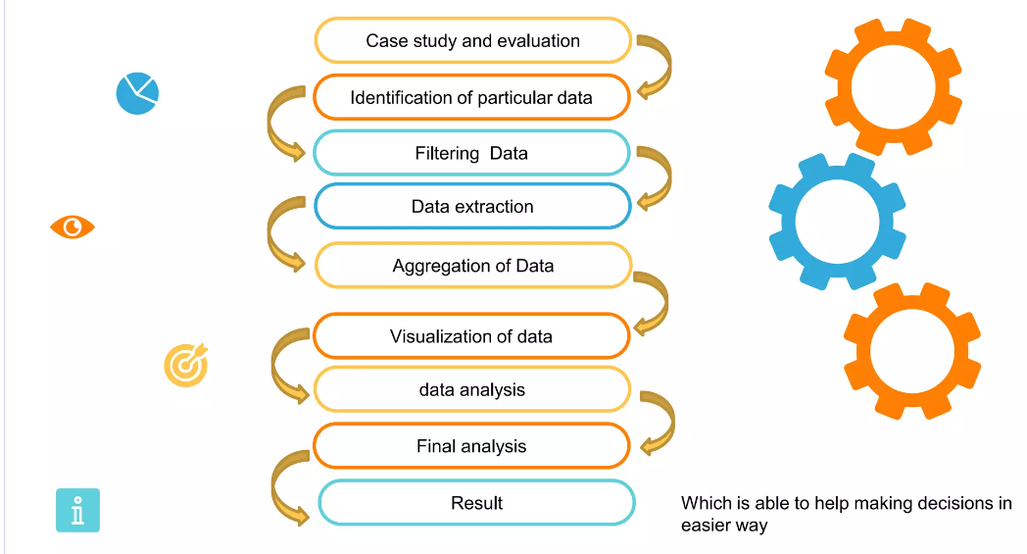
PROCESS OF BIG DATA ANALYTICS

Slide 11
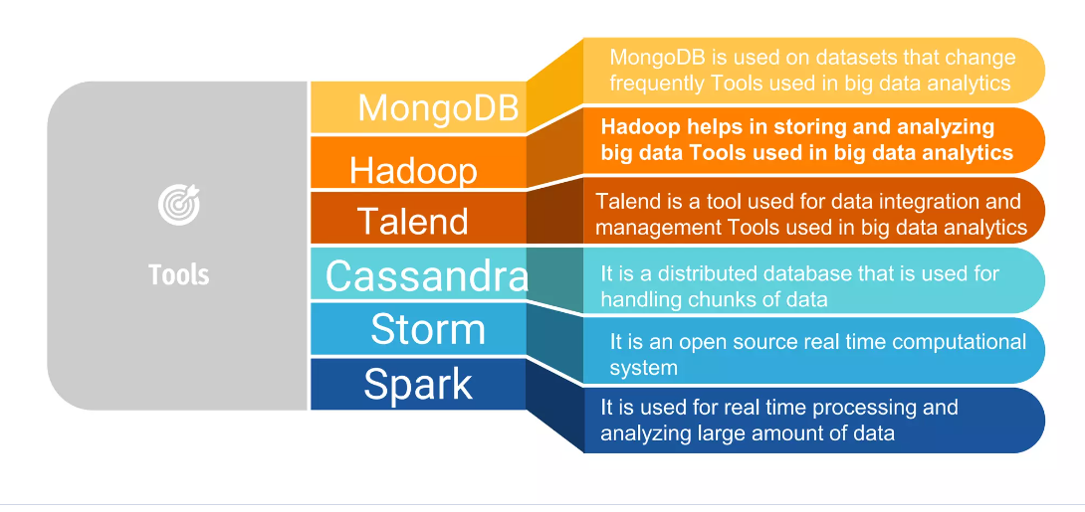
TOOLS USED IN BIG DATA ANALYTICS

Slide 12
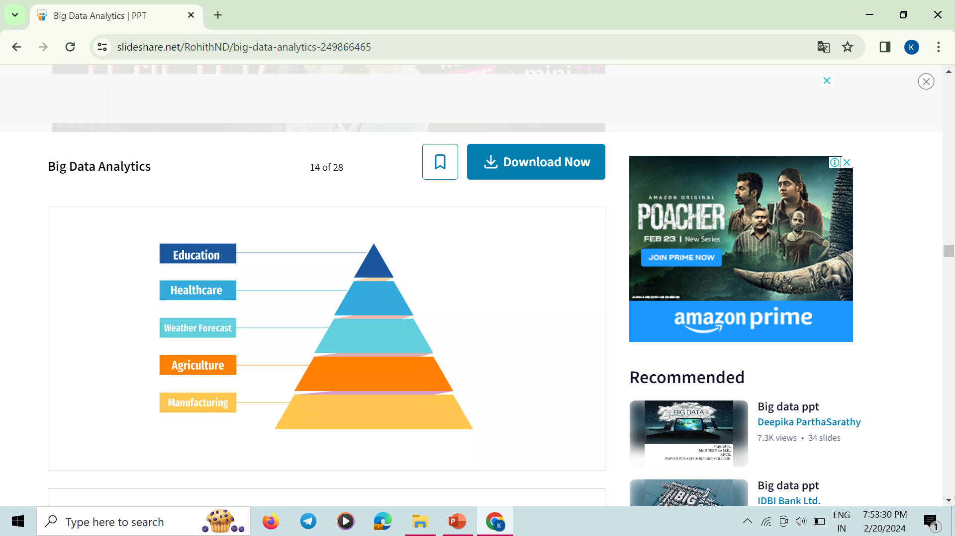
BIG DATA APPLICATION DOMAIN

Slide 13
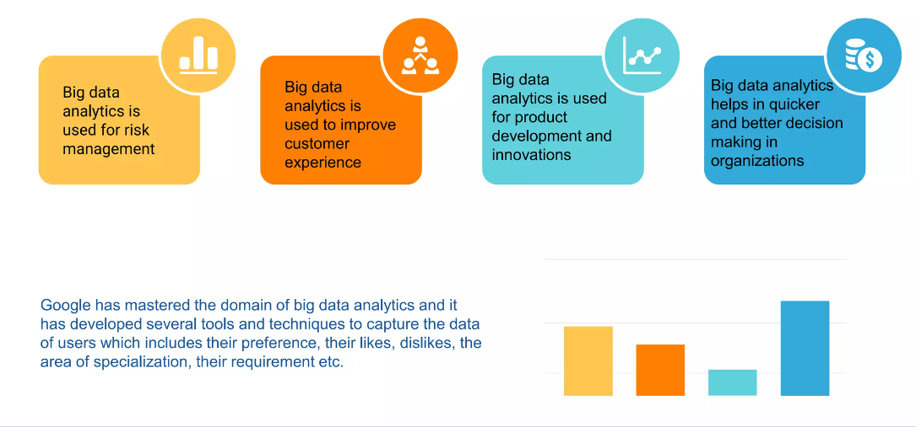
BENEFITS

Slide 14


Google Big Data
Google developed several open source tools and techniques that are extensively used in big data ecosystem.With the help of different big data tolls and techniques,Google is now capable of exploring millions of websites and fetch you the right answer or information within milliseconds

Slide 15
Big Data Analytics in Google
The first question that comes to our mind is how can Google perform such complex operations so efficiently?
The answer is Big data analytics.
Big data tools and techniques to understand our requirements based on several parameters like search history,location,trends etc.,
Google effortlessly displays the complex calculations which are designed to match the user’s requirements.

Slide 16
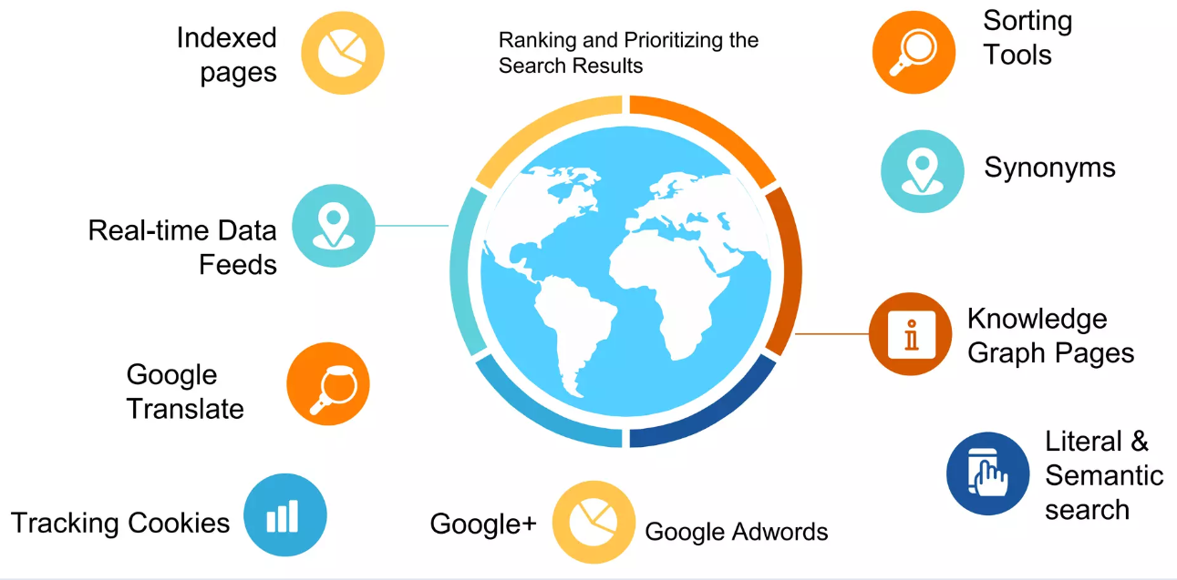
T Techniques used for Google Big Data

Slide 17
THANK YOU

